Slide 1
QR based ID Card to Quick Identification & Verification - Flask Application

Slide 2
Team Members
Class:
Name of the Supervisor:

Slide 3
Automatic Student ID Card using QR COde
In several cases students need Bonafide certificate (proof that they belong to a college) to get various benefits from Government.
Having QR Code embedded on ID card helps us to retrieve student information much faster.
So we build an Web portal where Student Information is stored, to generate ID Card and Bonafide Certificate automatically.

Slide 4
Scope
No intervention of office staff for generating Id card or Bonafide certificate.
Using QR code any information of the student can be fetched directly.
Can be extended to provide other features like a common place to give attendance etc.,
Students can download ID Card and Bonafide Certificate directly from web portal during this COVID Pandemic.

Slide 5
Objectives
Remove Intervention of Office people to update minor student information like Mobile Number and Email Address.
Remove Manual Storage of Information and Manual Searching to retrieve information.
Removal of traditional paperwork.
Reduce point of contact as much as possible during this COVID Pandemic.

Slide 6
Literature Review
S.No | First Author | Title | Year of Publication
1 | Abdul Rabu | The Design and Implementation of Student Attendance Tracking System Using QR Code Card | 2019
2 | Srinual Nalintipwong | Concurrent Self-Identification Applying QR Code to Record Class Attendance (QRClass) | 2019
3 | Asri Nuhi | Smart Attendance System using QR Code | 2020
4 | Sanaul Haque | Advanced QR Code Based Identity Card: A New Era for Generating Student ID Card in Developing Countries | 2014
5 | Arpankumar Patel | Smart Student Attendance System Using QR Code | 2019

Slide 7
Literature Review
S.No | First Author | Title | Year of Publication
6 | Sonali Patil | STUDENT IDENTIFICATION USING QR CODE | 2020
7 | B. V. Karlatthe | SMART AND UNIQUE CARD FOR COLLEGE STUDENT | 2021
8 | B.Dinesh Kumar | Smart Mobile Attendance System for Employees Using QR Scanner | 2017
9 | Ms.Apeksha Waghmare | QR code based Railway e-Ticket | 2018
10 | Mushtaq Hasson | Password authentication scheme based on smart card and QR code | 2021

Slide 8
How to generate QR Code using Python QR
Qrcode is an open source python library used to generate dynamic qr codes. The generated qr code can be saved as an image, and qr code can be directly used to display on browser or on pdf.
The Qrcode code library accepts either a string or an url as a parameter and generates qr code accordingly.
If a string is given as qr code only text is shown after scanning it. If a url is given as qr code then the qr code scanner asks whether to open url in browser or just copy the url.
There is also provision for manipulating qr code using logos and different styles, and different colors etc.

Slide 9
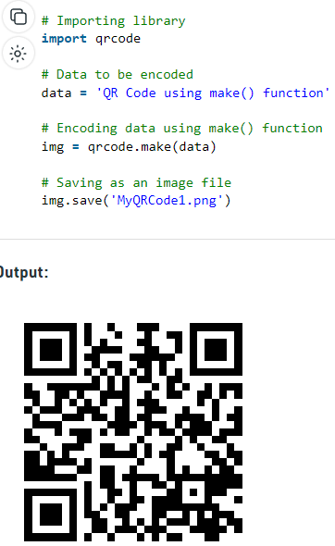

Slide 10
How to generate PDF using FPDF
Fpdf is an open source library used to generate pdf’s with required font’s etc.
Fpdf also contains fonts folder and any other dependencies required to generate a pdf.
We can write anything into the pdf including strings, images, urls, any multimedia.
All of the content should be placed into the exact position using x,y axis coordinates.

Slide 11
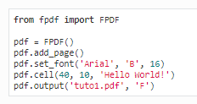


Slide 12
Proposed Model and Design
We propose to develop a web portal where all the student information is stored in a database. This helps both the office staff and student to easily access the information stored in database accordingly to their access rights.
Only admin/office staff can create a student record using the registration form. When a student record is created, all the information of the form is stored in the database, and login credentials are sent to the student via email.
Now the student can login into the system, view his/her profile download their ID card which will be having an QR code on it.

Slide 13
This qr code can be scanned to fetch all student information when the user logged in is the admin/office staff.
The student can generate an bonafide certificate on their own from their profile section after logging in using login credentials received via mail..
Based on the roles assigned for the students, office staff are redirected to their respective dashboard pages and certain features can be accessed.
Gym admin can access student gym related information only by scanning student qr code.

Slide 14
Library admin can get student library related information only by scanning the student id card qr code.
Library admin can also assign books after scanning student id qr code.
Whenever someone scans student id card qr code, the student gets a notification mail that someone is accessing their information.
Even if anyone other than admin role try to access student information by scanning student id card qr code, no information will be fetched.

Slide 15
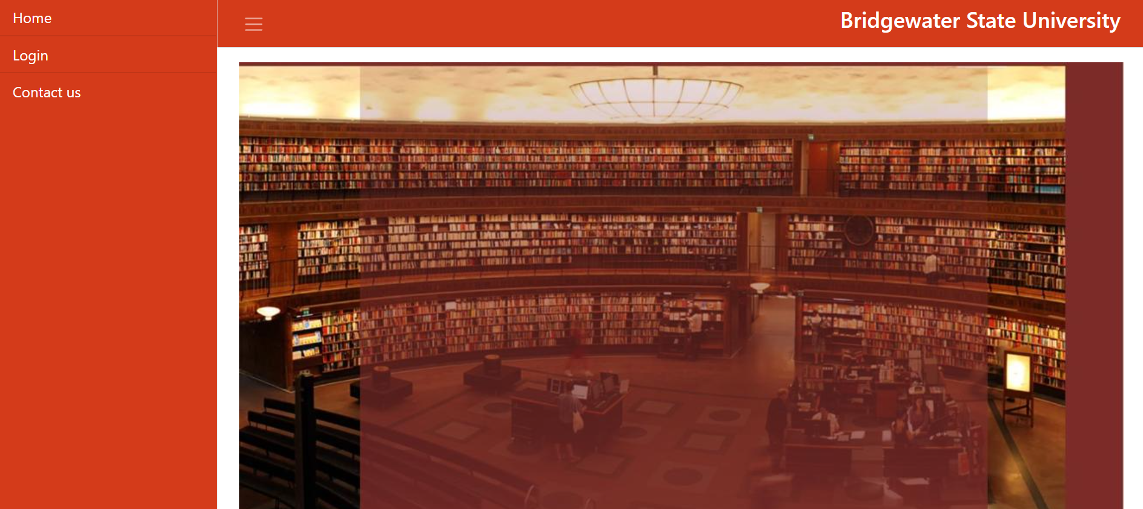
Screenshots

Slide 16
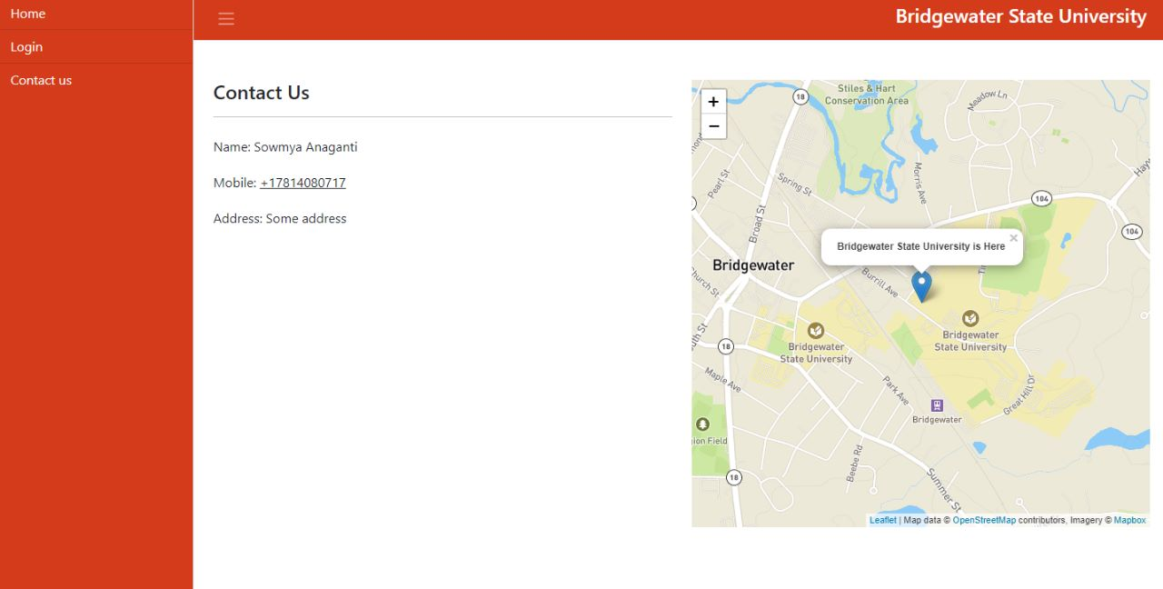
Contact Us

Slide 17
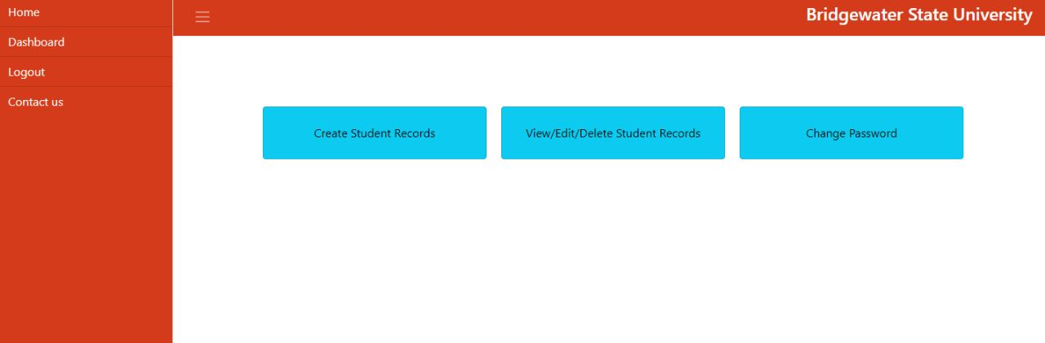
Office Admin Dashboard

Slide 18
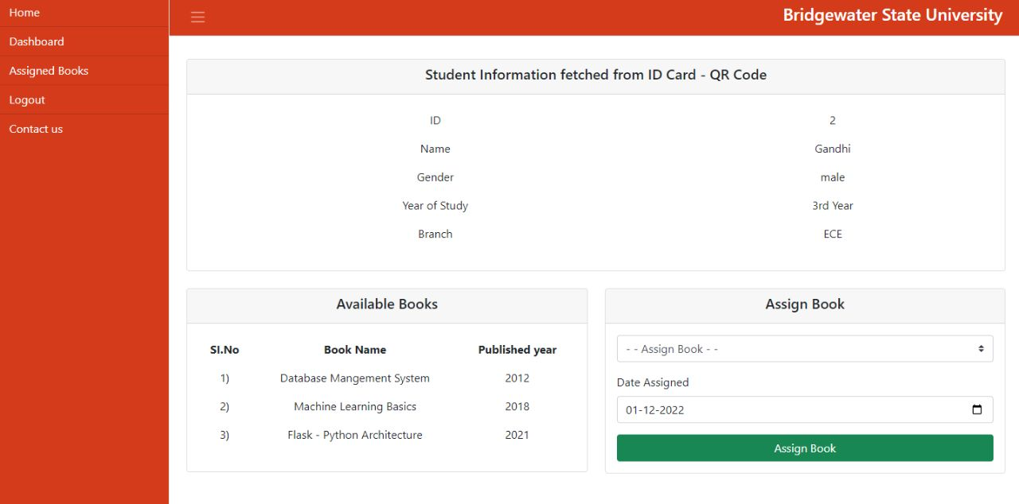
Library Admin Dashboard

Slide 19
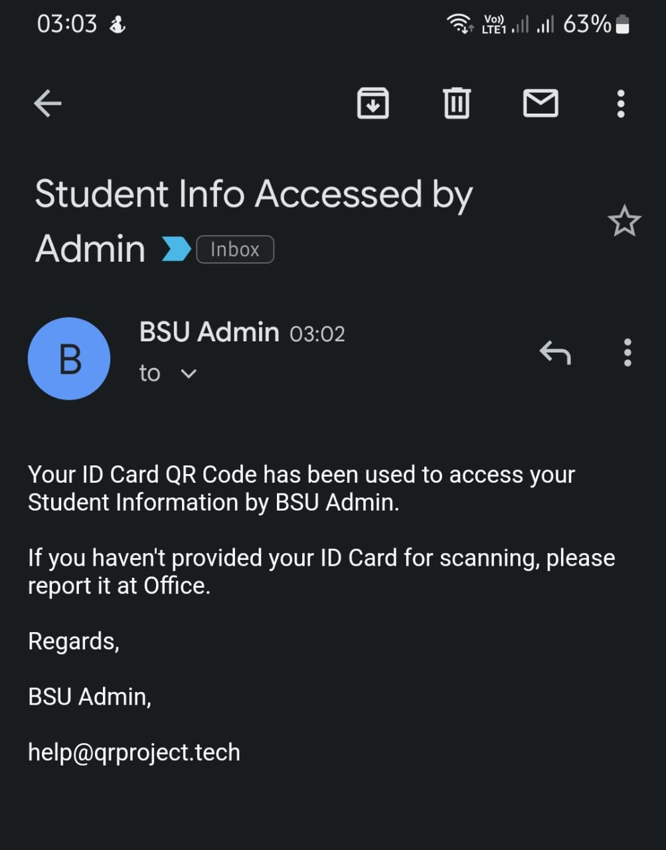
Student Getting mail when their qr code is used from id card

Slide 20
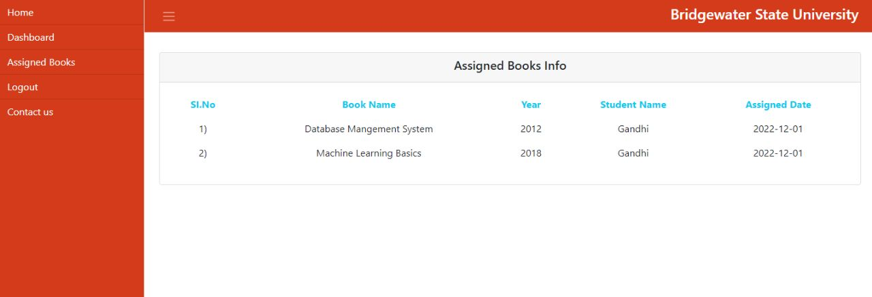
Assigned Books Page

Slide 21
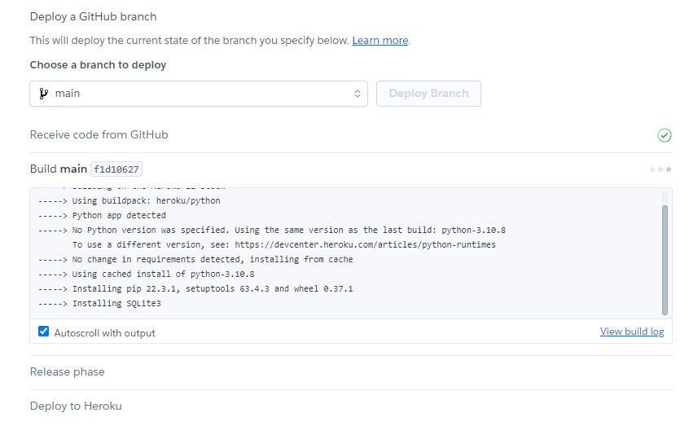
Deploying Flask Application into Heroku

Slide 22
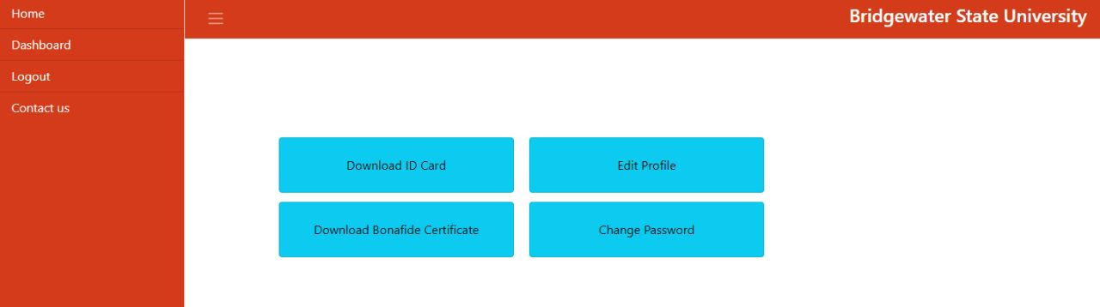
Student Dashboard Page

Slide 23
Future Scope
Project can be extended to develop attendance system using QR ID cards allowing lecturers to take attendance of large class in small time [1].
Project uses the qrcode code class which reduces the processing time to retrieve data from QR Code [2].
Projects aims at reducing manual work by office staff [3].
QR code can be used to retrieve student information and can be extended for various college related works. Bonafide certificate allows others to verify whether student belongs to the given college or not ? [4]
Mobiles can be used to scan the QR Code. So project can be easily extended to other models without any extra cost.

Slide 24
Reference Papers
https://www.ceeol.com/search/article-detail?id=783262
https://ieeexplore.ieee.org/abstract/document/8784518
https://ieeexplore.ieee.org/abstract/document/9134225
https://papers.ssrn.com/sol3/papers.cfm?abstract_id=3370769
https://d1wqtxts1xzle7.cloudfront.net/63950067/Advanced_QR_Code_Based_Identity_Card_A_N20200717-99945-16depcq-with-cover-page-v2.pdf?Expires=1628510616&Signature=dMT6qamkNpX1r5wVVIDD9rKW4F9VnXqZutkrOlKX5tHsje8deJkyfKAUDG2Et2U1JIgVk4mo3nKmzrC-naOVQSwwoJ9mb3Ep9BO7rV9ggUNNiHGnVqG-lzjqwSXf25mGGFM0PEL8GwwRkwvr2RHxqOFil0ntgueQmD1Ut7KwE7GDwZ7Tud-SRIUUZ6UoKMbcuUKgFSnFRSKJjVM38tY2j-jH7-LoTtS1Wd2kAYXMhZ5AtYGGSHnVYoOHXhIU3smhaAEr-wwz4pcbm-IlBR~wniujc8j30Jhf5NpVB41vUVU9GC6rCpR32t~roU05It0LIVCUpqyvDzNIqG0O0-eYqg__&Key-Pair-Id=APKAJLOHF5GGSLRBV4ZA

Slide 25
6. https://d1wqtxts1xzle7.cloudfront.net/64435798/IRJMETS634670-with-cover-page-v2.pdf?Expires=1629221296&Signature=Isr2oFGEYP-nZXmGR0w9g9bnYMPQulbHqmSUe9bXWjU~P3tPPmqLoSzYmVciliJi35T0RStOBFk6rSDegKmnIXFbOZtlpSUvQum1V6nu3Um6UzXcqjMLru0WpBXGGGExSpJtlQffKYfql6pXfC2YirVeQgGRcfRcXGzgeR4XKvoPukzjHZGnsla1RvLjtvCAo6HcmPpgW-VY9mv1S2VfRszgQhS9j6J1dbcvoX-OzYJvOOgbKNlp9TxVU1ESjBsEEJ4ZSOgjicRU8sUAYuw45wdOzoEyTqbIOyTjVP9gaVGuU~YPbN6FhZebIKao3ZqIc-H9FHHF1eY5yNDlLu3BYA__&Key-Pair-Id=APKAJLOHF5GGSLRBV4ZA
7. https://d1wqtxts1xzle7.cloudfront.net/66015654/IRJMETS614515.pdf?1615805634=&response-content-disposition=inline%3B+filename%3DSMART_AND_UNIQUE_CARD_FOR_COLLEGE_STUDEN.pdf&Expires=1629221308&Signature=SLyn9qx6J-xUpjFhNckFn8V8zpob-atQg3J2C~VojLvJsXA42yPknM0fRynYWfXeBFz~FQ8eaAkHgm667atFLTgagkW73Jnog~VedRee~JgM-rzDFrjZ04kxUZ78F3ALi4-SKSLfMv1bo7b7eWYj1Zgur~PrrKeV9GgI1Z6Qi7l-8NS-XZlT4aG37wEznfl8rqHOqhKA0s6LSF64yf5hrSVddLxrUNaVam10NvA4QpmZ0Jcc0aEwHCfT3ugDDilelBmZyryYCbtXec4xYL6LjS0LUHYF0ltKotJ2zlBcLXaIK3sQ123LSgawKtPLKS8ZlKYbkwXAd4mfXAXmu8Dt~Q__&Key-Pair-Id=APKAJLOHF5GGSLRBV4ZA

Slide 26
8. http://ajast.net/data/uploads/11.pdf
9. https://www.researchgate.net/publication/333344979_QR_code_based_Railway_e-Ticket
10.
https://www.researchgate.net/profile/Ali-Adil-Yassin/publication/353322811_Password_authentication_scheme_based_on_smart_card_and_QR_code/links/60f417adfb568a7098b9cf02/Password-authentication-scheme-based-on-smart-card-and-QR-code.pdf

Slide 27


